Slide 1
Pytextrank and Keras
NLP Graph Algorithm with Deep Learning for Clinical Trials Classification

Slide 2
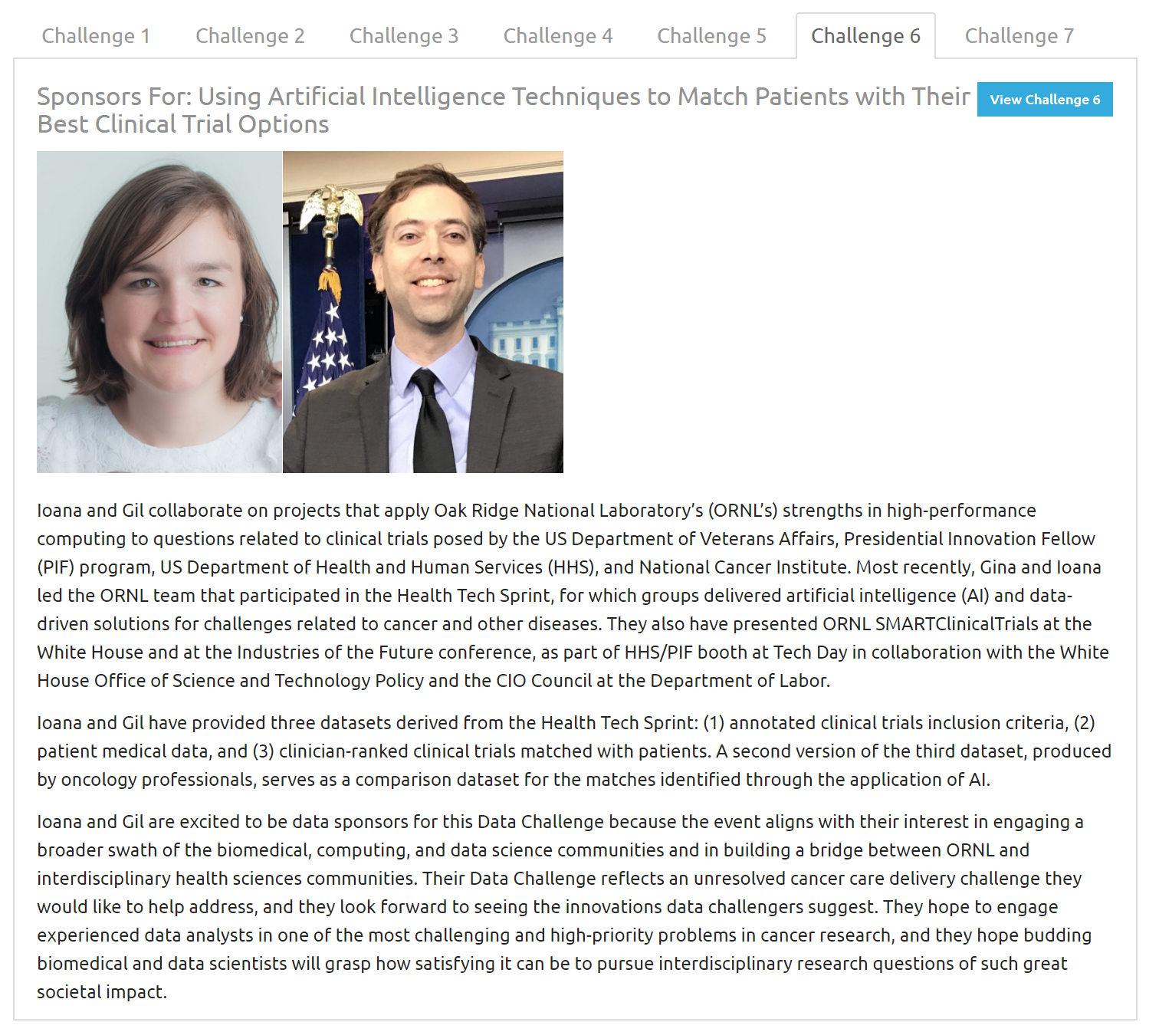

ORNL Data Science Challenge
https://smc-datachallenge.ornl.gov/
Notes:
Keras code is actually pretty straightforward – the data preprocessing isn’t..

Slide 3
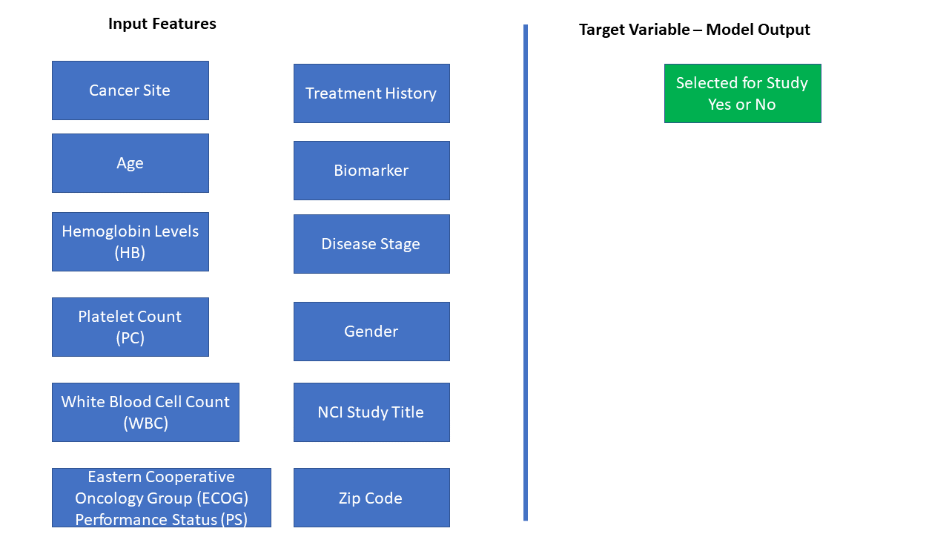

Slide 4
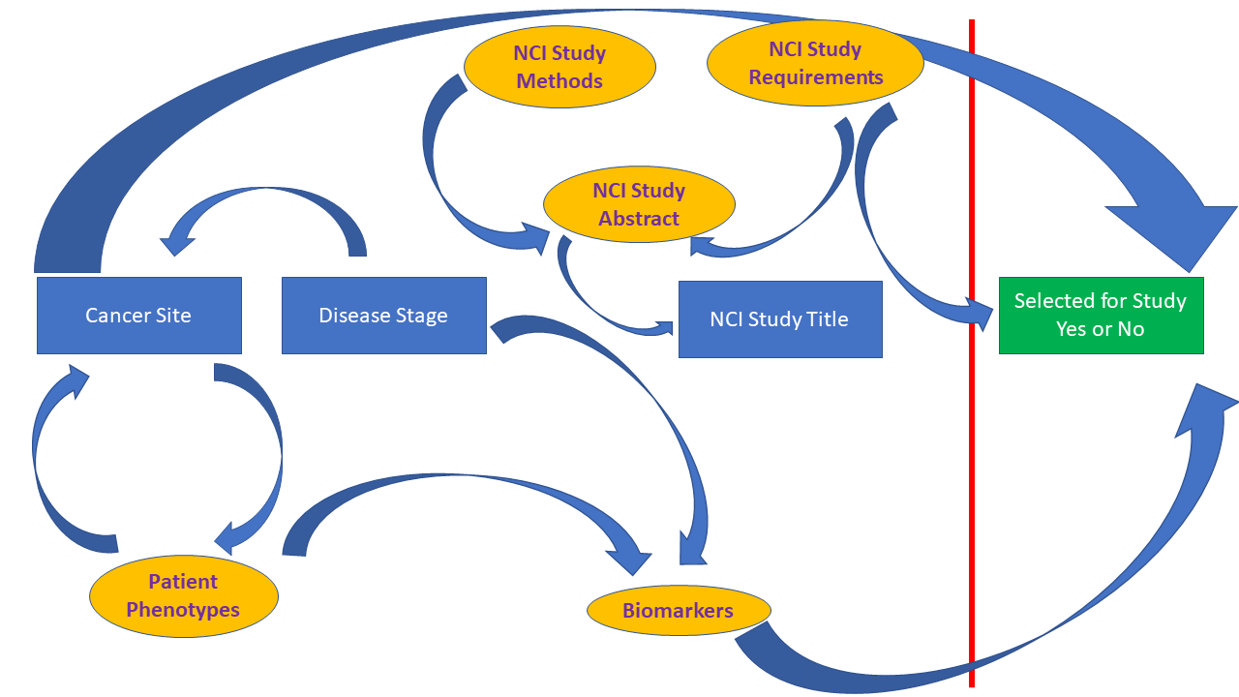

Slide 5
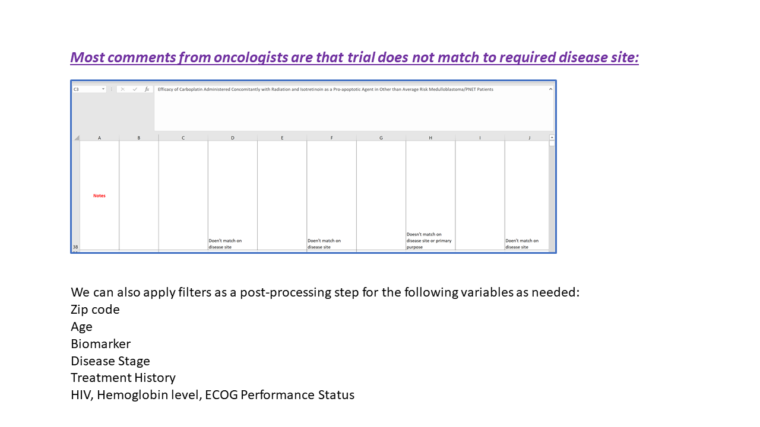

Slide 6
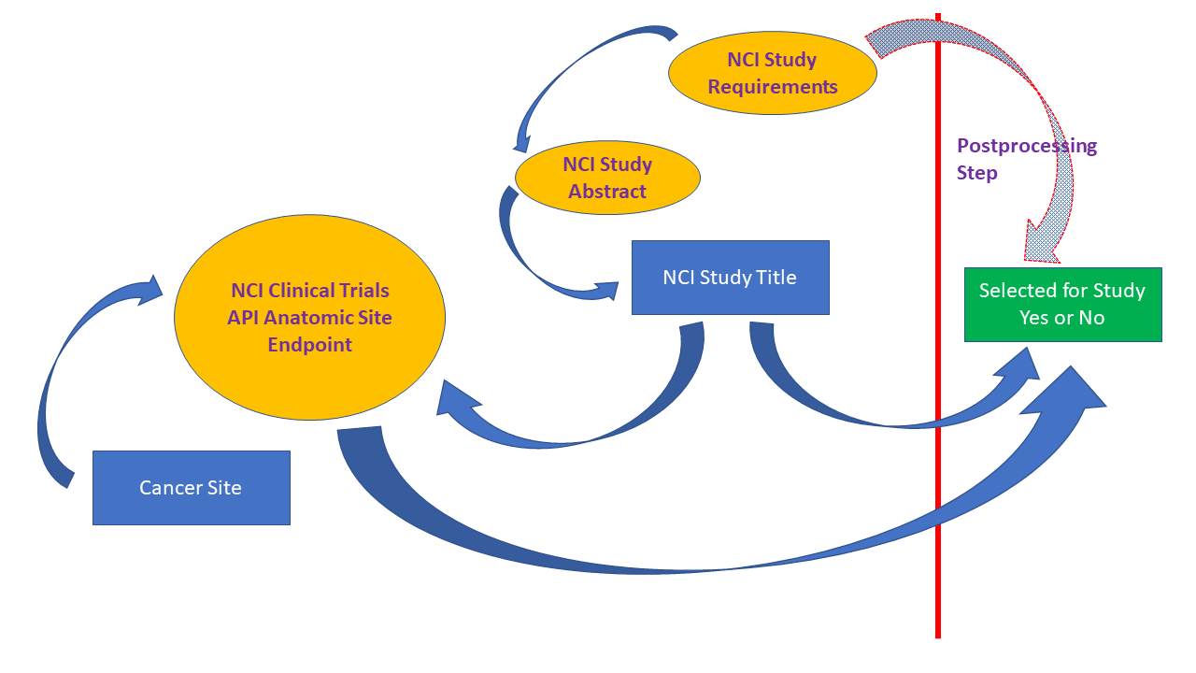

Slide 7
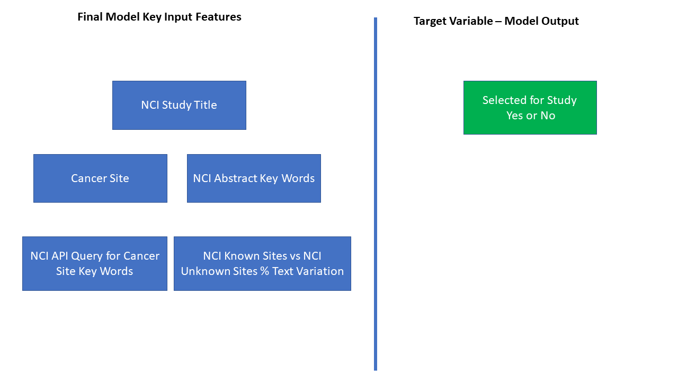

Slide 8
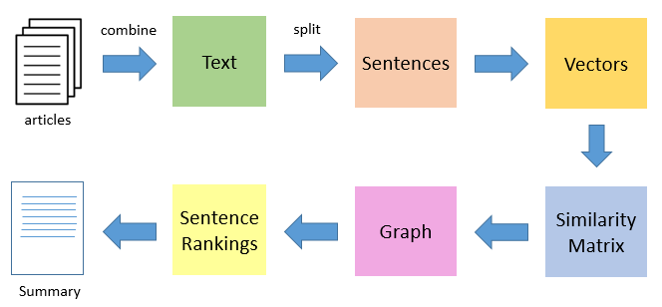
Pytextrank Algorithm
https://medium.com/@aneesha/beyond-bag-of-words-using-pytextrank-to-find-phrases-and-summarize-text-f736fa3773c5

Slide 9
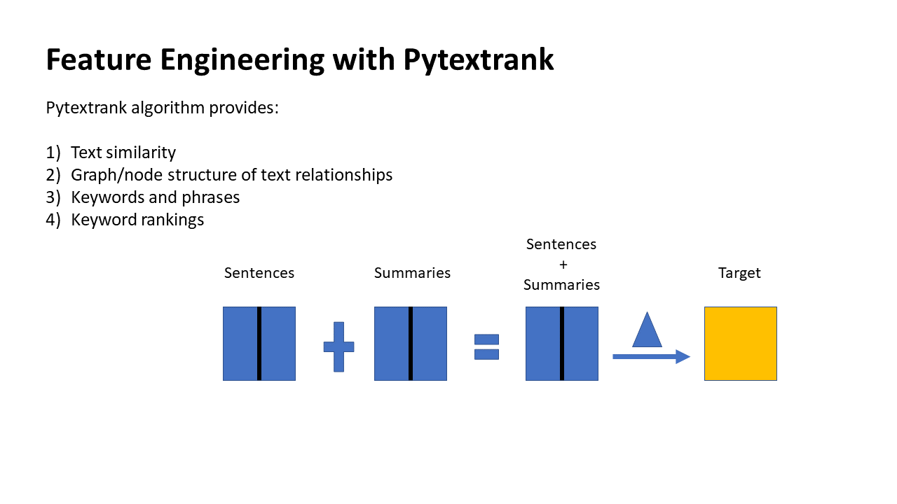

Slide 10
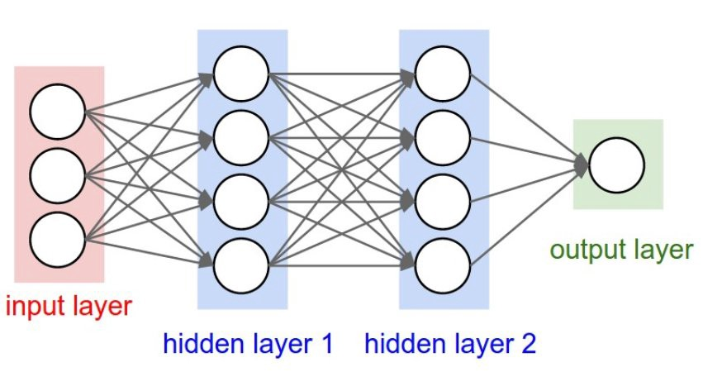
Deep Learning with R (Keras)
https://github.com/jjallaire/deep-learning-with-r-notebooks
Notes:
Keras code is actually pretty straightforward – the data preprocessing isn’t..

Slide 11
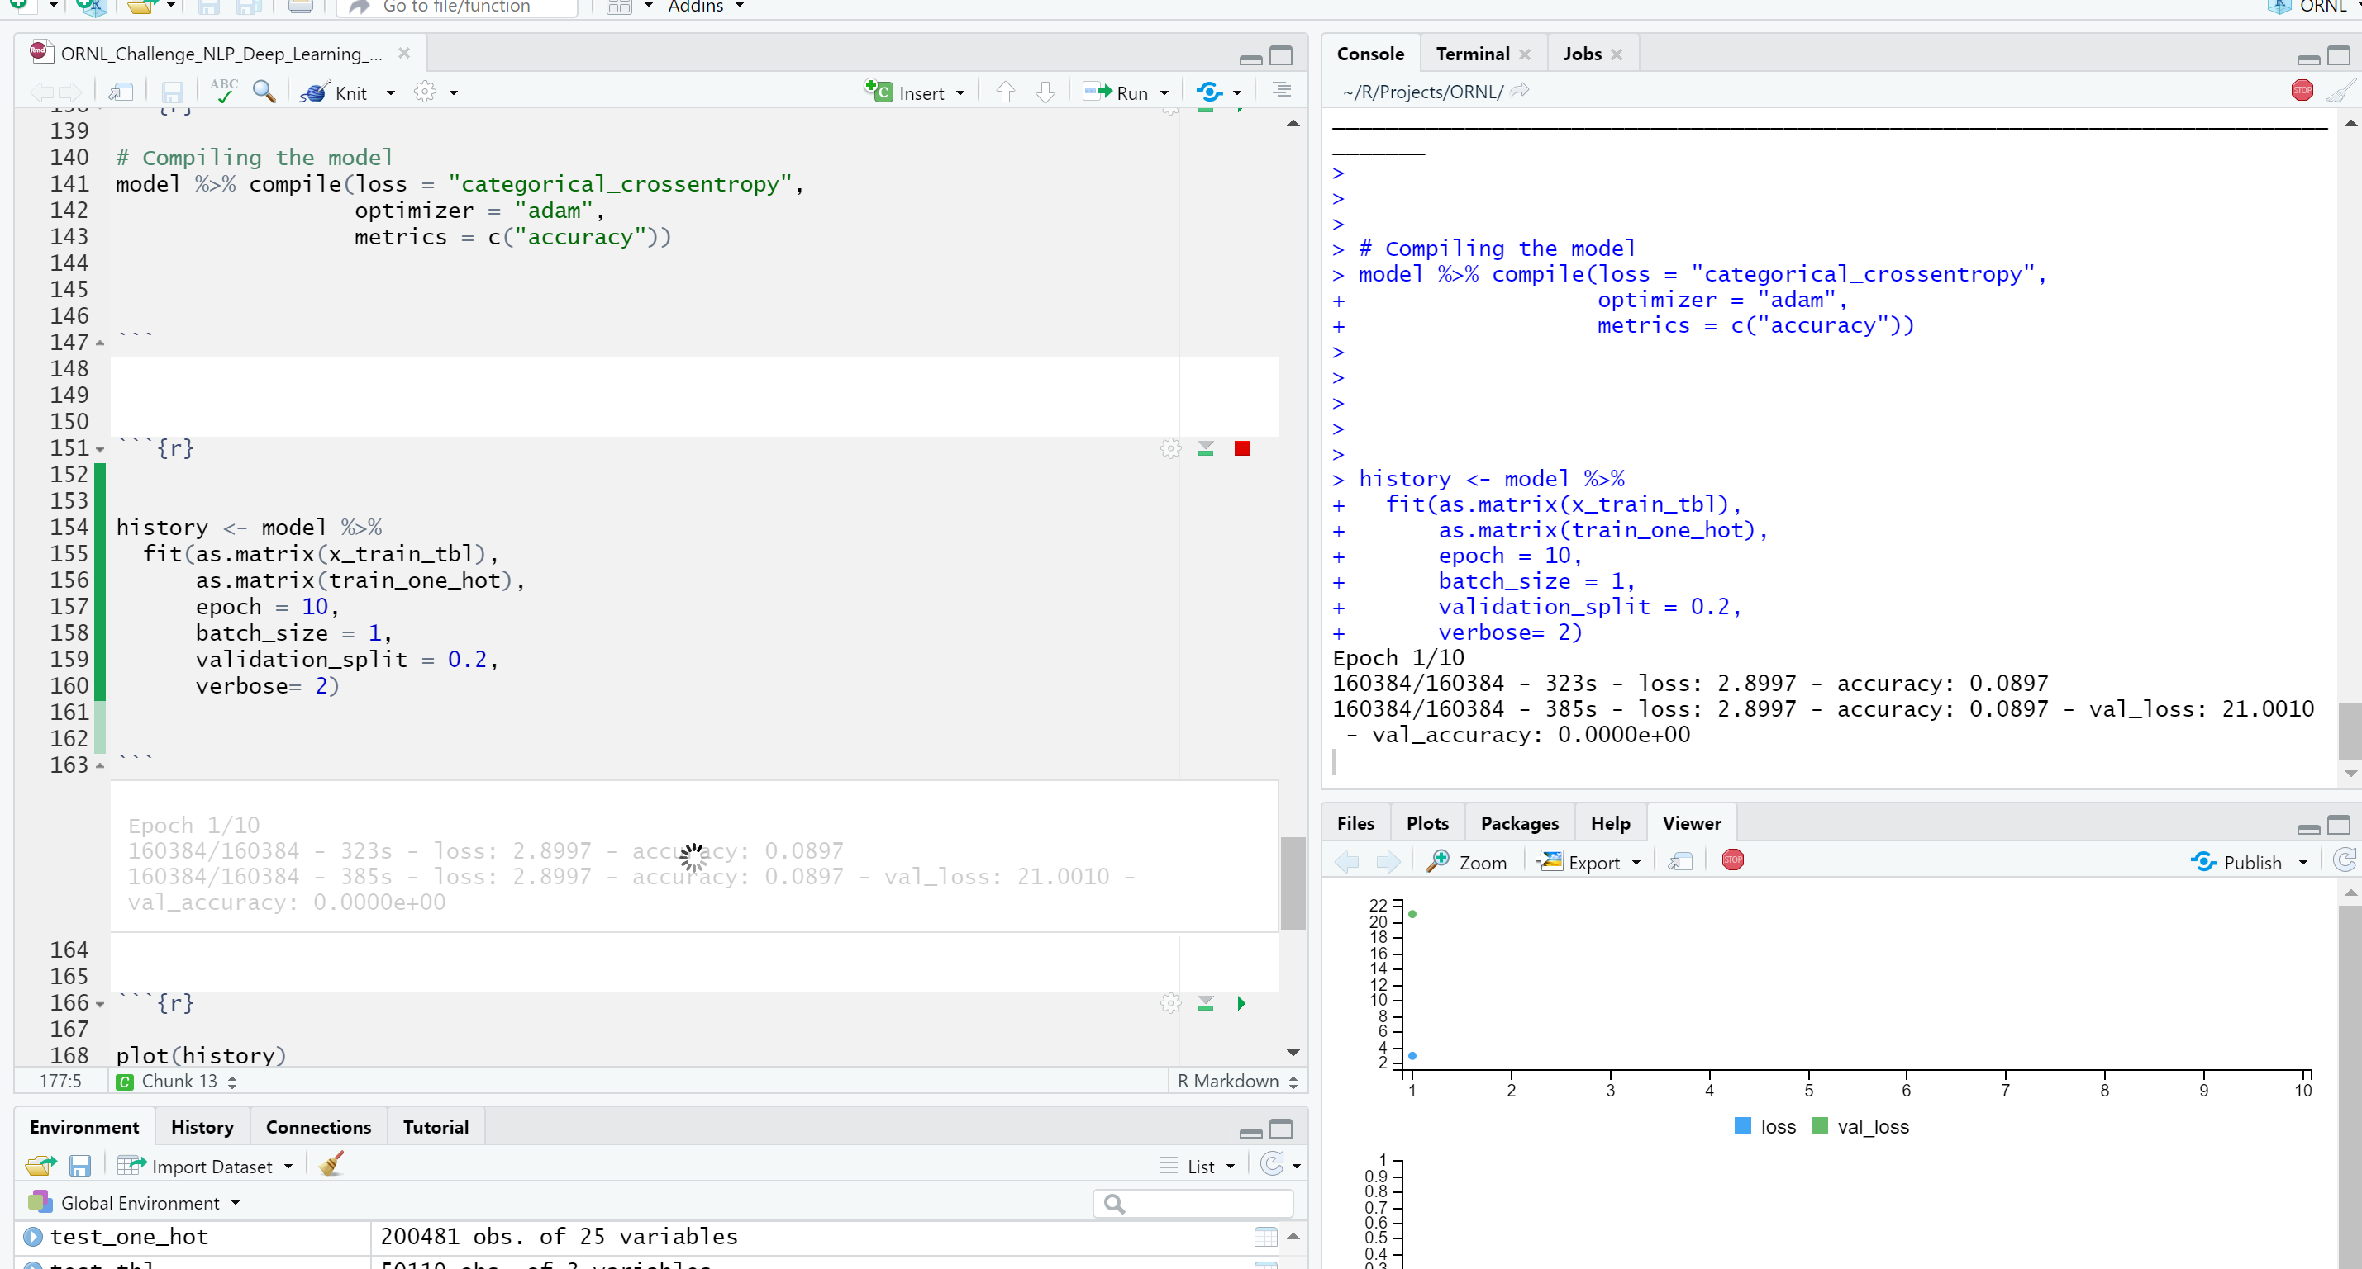

Slide 12
Python – R:
Reticulate Demo with Pytextrank

Slide 13
Large Datasets – Need More Compute..

Slide 14
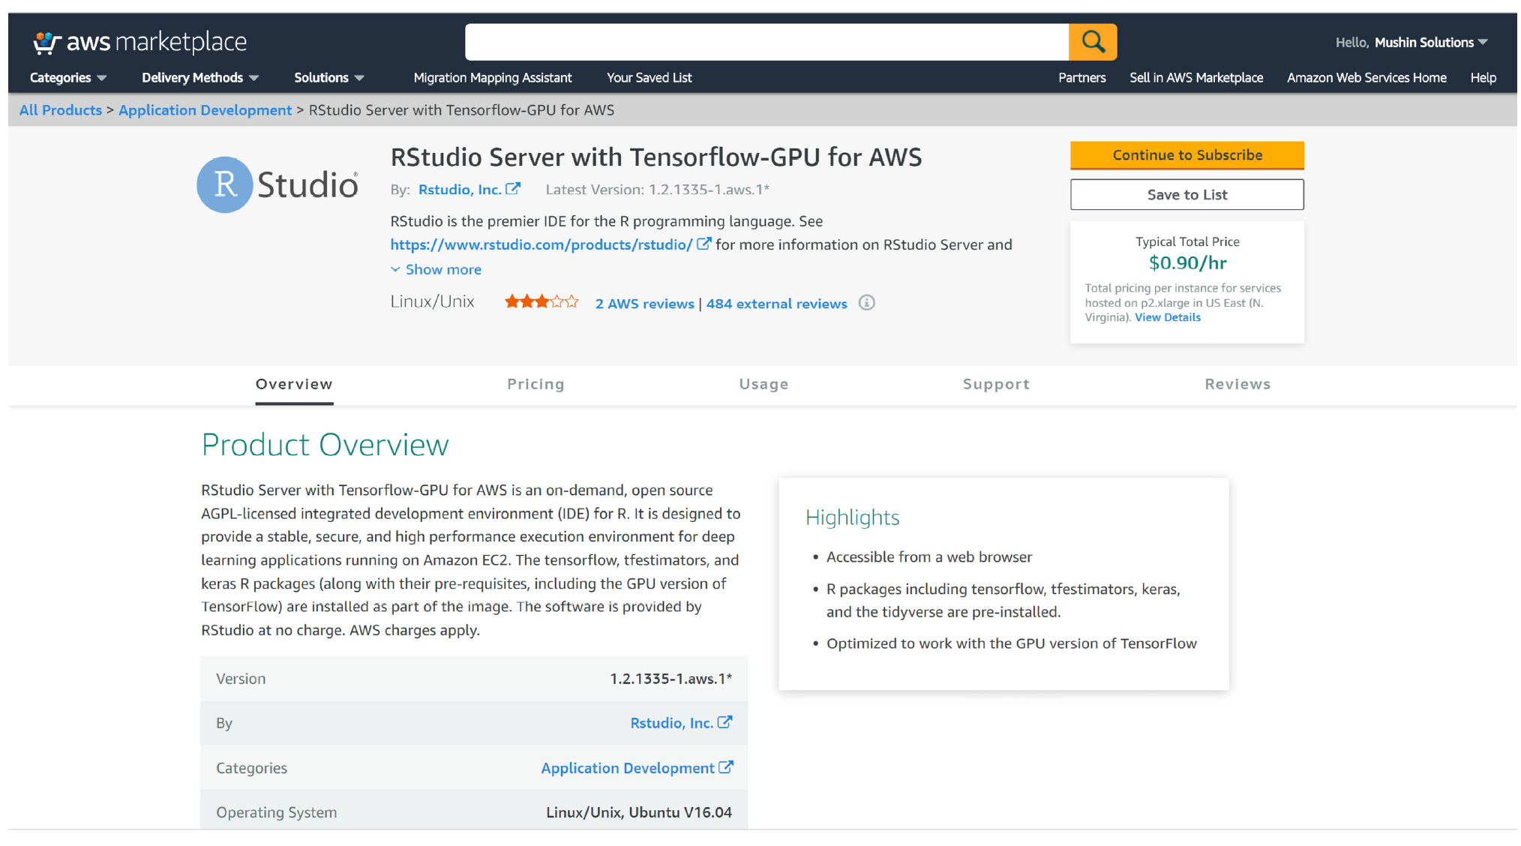

Slide 15
Python 2.7 – Really??
Notes:
Python

Slide 16
So We Build Our Own..Next CAR

